Slide 1
Java Virtual Machine Profiling

Slide 2
Agenda
Introduction
JVM overview
Performance concepts
Monitoring
Profiling
VisualVM demo
Tuning
Conclusions
Notes:
Introduction
JVM overview
Performance basics
Performance methodology
Monitoring
Profiling
VisualVM live demo
Tuning
Conclusions

Slide 3
Introduction
What? Monitoring JVM -> Profiling JVM -> Tuning
Who? Java SE developers, Java EE developers, Java architects, Java apps admin
What not? SO perf, I/O perf, Network perf, JIT perf
Notes:
JVM concepts: Memo
JVM performance issues: Gus
Profiling: Alex
JDK built-in tools: Alex
VisualVM live demo: Memo
VisualVM plugins: Memo

Slide 4
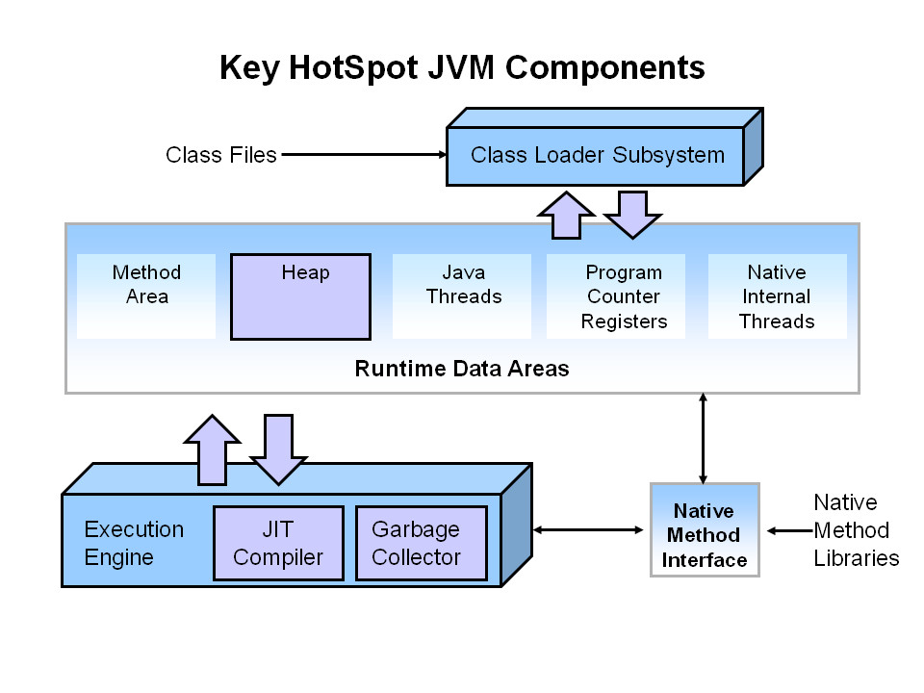
JVM overview

Slide 5
Performance basics
Memory footprint
Startup time
Scalability
Responsiveness
Throughput
Notes:
Memory footprint: memory used by an app, or memory used by a JVM
Tune the heap size to avoid virtual memory swapping.
Startup time: time taken to start.
Avoid large classpaths
Consider disable bytecode verification, this avoids overhead loading classes
Scalability: how well an app performs under load increments
Lineal increments of response time is good, exponential is bad.
Stress your application in development, not in production
Responsiveness: how quickly an app responds with a request. Respond in short period of time.
Throughput: amount of work in a period of time. Do more work in the same time.

Slide 6
Performance methodology
Monitoring
  Not intrusive: observe behavior, not overload
  For development/production
  For troubleshooting: identify issues
  Tuning info for: JVM issues (heap size, GC optimization, JIT bugs)
Profiling
  More intrusive: analyze your code, cause overload
  For development: get performance data in a running app
  For troubleshooting: focus on the issues
  Tuning info for: code issues (memory leaks, lock contentions)
Tuning
  Known performance requirements
  Monitoring and/or profiling, then compare with requirements
  Modify JVM arguments or source code
Incorporating performance in development
  Analysis -> Design -> Code -> Benchmark -> Profile -> Deploy

Slide 7
Monitoring
What to monitor?
    CPU usage
    Java heap usage,
    # of threads
    GC: frequency and duration
    JIT: frequency, duration, opt/de-opt cycles, failed compilations
Result
  Identify Java heap tuning
  GC tuning
Tools for monitoring
  -verbose: gc,
  -XX:+PrintGCDetails, -XX:PrintCompilation
  Jstat
  JConsole, VisualVM, VisualGC

Slide 8
Profiling
CPU profiling
  When: large amount of CPU time
  Look for: methods with a high self-time
  Output: throughput issues, identify algorithm and designs issues
Heap profiling
  When: GC runs frequently, large Java heap
  Look for: very large allocated objects, small objects allocated at a high rate
  Output: throughput/responsiveness issues, memory allocation patterns, memory strategies (alternative APIs, caching solutions)

Slide 9
Profiling (continued)
Memory leaks: reference to allocated object remains unintentionally reachable and cannot be GC'ed.
  When: Java heap grow over time w/o bound, OOM errors
  Look for: abnormal memory consumption,
  Output: code errors
Lock contention: large number of context switches, related to CPU utilization
  When: manual use of threads
  Look for: high number of context switches, many threads in wait state
  Output: code errors.
Tools for profiling
  Netbeans profiler
  jmap, jhat
  -XX: +HeapDumpOnOutOfMemoryError
  VisualVM

Slide 10
Profiling tecniques
 | Sampling | Profiling
Code modification | No | Yes, at bytecode level in startup time.
Overhead | Only when sampling, depends of frequency of sampling. | Large, depends of number of instrumented methods and number of threads.
Accuracy | Not to much, better with high frequency | Accurate
Repeatability | Different results in different measures | Similar results
When? | Synchronization problems Profiling a production application Identify performance bottlenecks | Analyze performance bottlenecks Precise information

Slide 11
Profiling tools
Included in <JDK_HOME>/bin for JDK 1.5+, except jhat (JDK 6+) and jvisualvm (JDK 6 update 7+)
jps: list the instrumented HotSpot VM’s for the current user in the target system.
jinfo: prints system properties and command-line flags used in a JVM
jmap: prints memory related statistics for a running VM or core file
jhat: parses a heap dump in binary format and starts an HTTP server to browse different queries (JDK 6)
jstat: provides information on performance and resource consumption of running applications using the built-in instrumentation in the HotSpot VM.
jstack: prints the stack traces of all the threads attached to the JVM, including Java threads and VM internal threads. Also performs deadlock detection
jconsole: uses the build-in JMX instrumentation in the JVM to provide information on performance and resource consumption of running applications
jvisualvm: useful to troubleshoot applications and to monitor and improve application’s performance. It helps ot generate and analyze heap dumps, track down memory leaks, perform and monitor garbage collection, and perform lightweigth memory and CPU profiling.

Slide 12
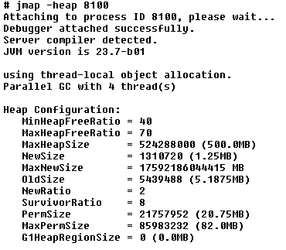
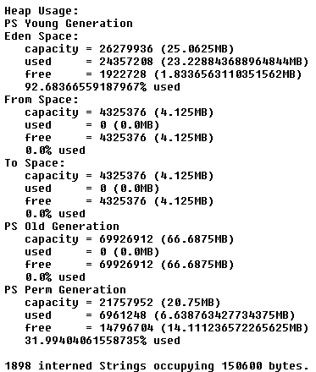
Profiling tools (continued)

Slide 13
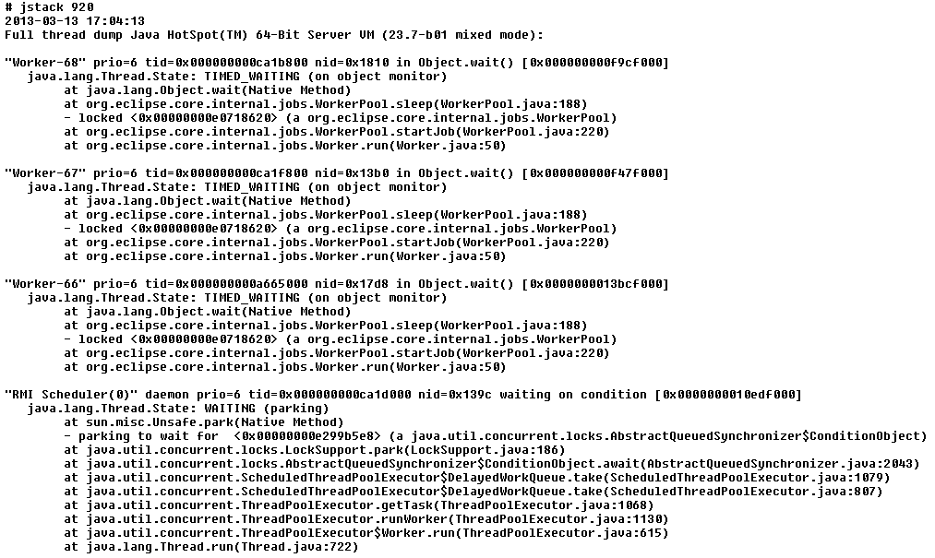
Profiling tools (continued)

Slide 14
VisualVM demo
The bleeding-edge distribution of jvisualvm, with the latest features and bug fixes.
Download software: http://visualvm.java.net/ (current version 1.3.5)
Enable JVM profiling
  -Dcom.sun.management.jmxremote=true: Registers the JVM instrumentation MBeans and publishes the RMI connector via a private interface to allow JMX client applications to monitor a local JVM.
  -Xshare:off: Disable class data sharing
  -javaagent:<VISUALVM_HOME>/profiler/lib/jfluid-server.jar: Specify where is the profiler agent
Start VisualVM
  # <JVISUALVM_HOME>/bin/visualvm –-jdkhome <JDK_HOME>
Notes:
- Sampler tab columns:
- Self time: time spent in all invocations on this method (excluding further method calls)
- Self time [%]: expressed in percentage
- Self time (CPU): estimated real CPU use time
- Sampler snapshot columns:
- Time: time spent in all invocations of the method
- Time [%]: percentage relative to the thread time (100% is the thread total time captured in the snapshot)
- Time (CPU): estimated CPU real use time
- Invocations: number of times the method was called
- Profiling columns (tab and snapshot):
- Time [%]: time spent in all invocations of the method, expressed in percentage. The 100% is the time the thread has been running.
- Time: time spent in all invocations of the method, expressed in milliseconds.
- Invocations: number of times the method was called.

Slide 15
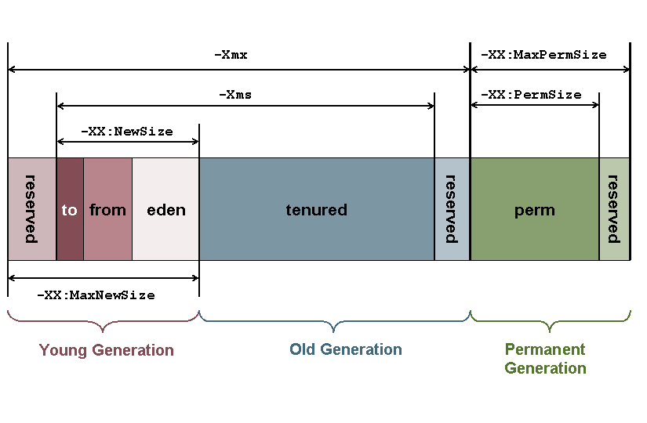
Tuning
Java heap and stack tuning

Slide 16
Tuning (continued)
Heap and lock contention issues:
  Avoid create objects where primitives could be used (autoboxing is not for free)
  Avoid String concatenations, use StringBuilder with append()
  Avoid StringBuilder overallocation, set initial size to reduce resizing
  Avoid use of synchronized keyword, look for a java.util.concurrent solution
  Use java.util.concurrent API instead of "synchronized" Collections
  Don't use exceptions for flow control (Exception objects allocation), use flow control constructs (if/else, return, switch).
  Don't generate stack traces, they're expensive operations.
  Reduce number of system calls:
    Avoid accessing disk: use large buffers or direct buffering
    Avoid accessing to underlying OS
    Avoid processing bytes and characters individually
  Never implement finalize(): pain in the ass for GC
GC issues: not covered

Slide 17
Conclusions
JDK offers very useful utilities to troubleshoot and manage performance issues with JVM.
We can use them not only when a performance issue happens, but to understand what is the behavior of the application and where could be improve it.
Incorporate performance benchmarks in your development cycle.
Thanks!

Slide 18
References
Memory Management in the Java HotSpot Virtual Machine
  http://java.sun.com/j2se/reference/whitepapers/memorymanagement_whitepaper.pdf
Troubleshooting Guide for Java SE 6 with HotSpot VM
  http://www.oracle.com/technetwork/java/javase/toc-135973.html
JDK Utilities
  http://download.oracle.com/javase/6/docs/technotes/tools/share/jps.html
  http://download.oracle.com/javase/6/docs/technotes/tools/share/jinfo.html
  http://download.oracle.com/javase/6/docs/technotes/tools/share/jmap.html
  http://download.oracle.com/javase/6/docs/technotes/tools/share/jhat.html
  http://download.oracle.com/javase/6/docs/technotes/tools/share/jstat.html
  http://download.oracle.com/javase/6/docs/technotes/tools/share/jstack.html
  http://download.oracle.com/javase/6/docs/technotes/tools/share/jconsole.html
  http://download.oracle.com/javase/6/docs/technotes/tools/share/jvisualvm.html
Visual VM
  http://visualvm.java.net/
JVM HotSpot options
  http://www.oracle.com/technetwork/java/javase/tech/vmoptions-jsp-140102.html

